Slide 1
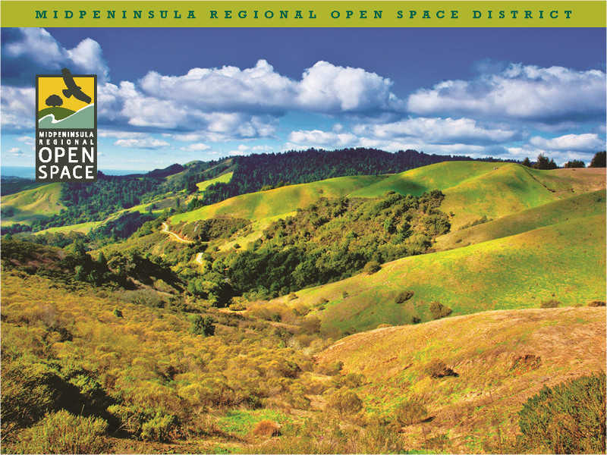
The Midpeninsula Regional
Open Space District
A Presentation to the Napa County Regional Park and Open Space Committee
By MROSD General Manager Steve Abbors
Thursday
January 8, 2015

Slide 2
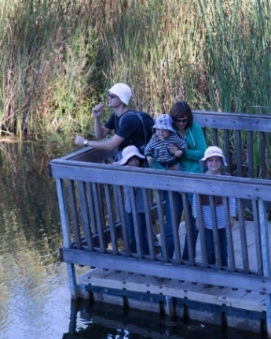
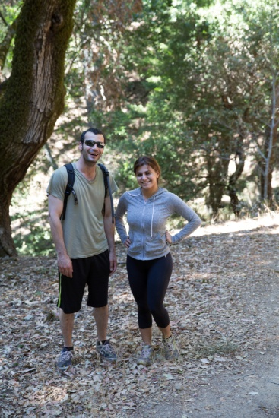
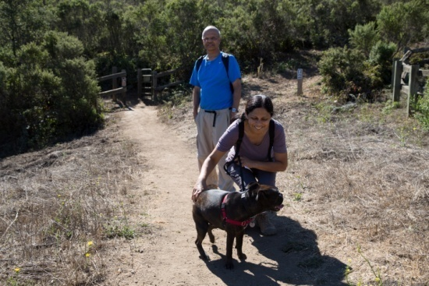
Mission
To acquire and preserve a regional greenbelt of open space land
in perpetuity, protect and restore the natural environment, and provide opportunities for ecologically
sensitive public enjoyment
and education.

Slide 3
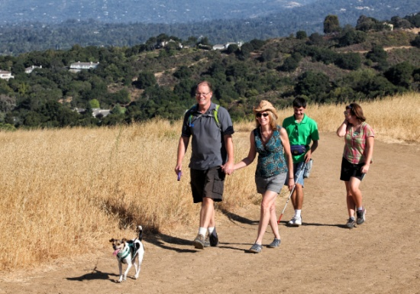
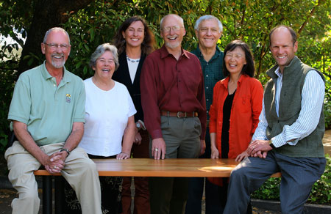
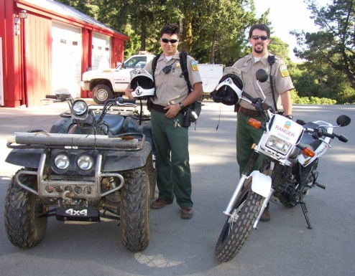
About the Open Space District
Created in 1972 by a grassroots voter initiative
26 preserves, 62,000 acres, 225+ miles of trails in
Santa Clara, San Mateo and Santa Cruz counties
Seven-member elected board of directors
125 Employees
500 volunteers - 18,000+ hours of service
Over 300 public interpretive activities per year
through volunteer docents

Slide 4
2014-2015 Budget
2014-15 Budget $43.9 million
2014-15 Expenditures
Policy – Formulaic budget with operating and capital expenditures not to exceed 65%
Debt service currently at 20%
Notes:
District practice for 40 years was to take on debt to finance land purchase. Formulaic budget protects maximum funds to purchase land.
approximately what percentage of your District revenues come from user fees?
--approximately what percentage of your District revenues come from grants, gifts and donations?
--does your District have a foundation or other non-profit partner that solicits donations for District projects and programs? If so, how effective is it?

Slide 5
Percentage of Revenue
5 Year Average (without Land Donation)
Property Management = on property housing rental, agreement with Santa Clara County Parks, grazing leases.
Other = Investment income; cash donations, book sales, user fees, insurance reimbursements, etc.
Land donations fluctuates widely from 0% to 30% over past 5 years.
Notes:
District does not have Foundation but does receive donations around $25k per year from private citizens.

Slide 6
The Need for an
Additional Revenue Source
Cash Flow Projections (in millions)
Fiscal Year | 2010- 11 | 2011-12 | 2012-13 | 2013-14 | 2014-15 | 2015-16 | 2016-17 | 2017-18
Tax Rev | 27.53 | 27.81 | 28.44 | 29.43 | 30.91 | 32.45 | 34.07 | 35.78
Tax Grwth | 0% | +1.0% | +2.25% | +3.5% | +5% | +5% | +5% | +5%
OpEx | 13.76 | 14.22 | 15.00 | 15.98 | 17.10 | 18.29 | 19.57 | 20.94
OpEx/TR | 50% | 51% | 52% | 54% | 55% | 56% | 57% | 58%
CapEx | 2.02 | 4.60 | 3.02 | 3.12 | 3.28 | 3.44 | 3.61 | 3.79
Debt Svc | 8.09 | 10.59 | 10.26 | 9.71 | 10.67 | 11.88 | 11.70 | 12.01
Cash-Land $40M Debt | 11.49 | 12.41 | 9.50 | 9.50 | 9.50 | 9.50 | 5.70 | 1.19
Cash-Land $0M Debt | 14.48 | 11.49 | 9.50 | 2.85 | 3.80 | 3.56 | 2.38 | 2.85
Notes:
30 year financial model
We know our cash flow, debt service, planned growth and tax revenue growth.
Particularly after 08-09, we realized…

Slide 7
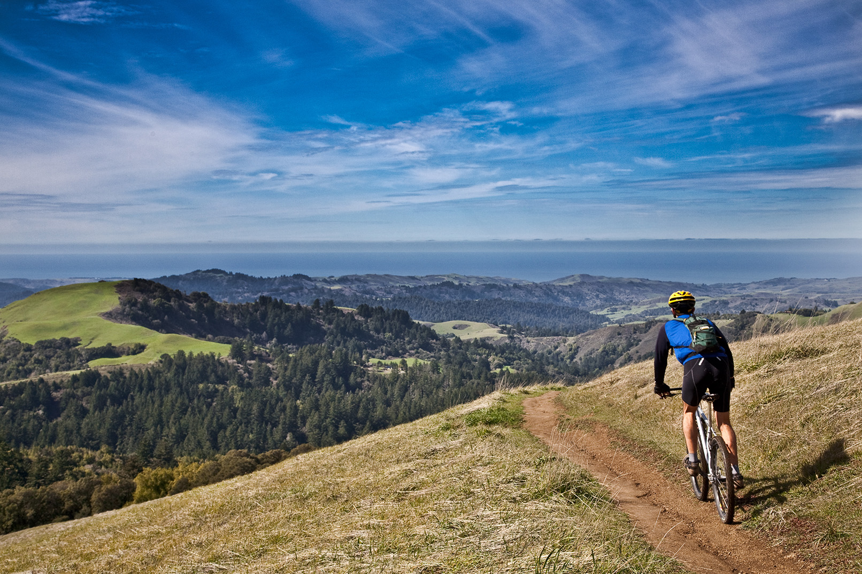
Financial Forecast 2017
Without an additional revenue source, funds to purchase land would be depleted by 2017; operating expenses were rising; preserve usage and public demand for access were increasing.
Notes:
We needed a new strategy to realize the full mission of the District
At this point, the district was 39 years old
45% of the preserves still closed
Partners and public were asking for greater access
Opportunities to acquire land getting more and more scarce

Slide 8
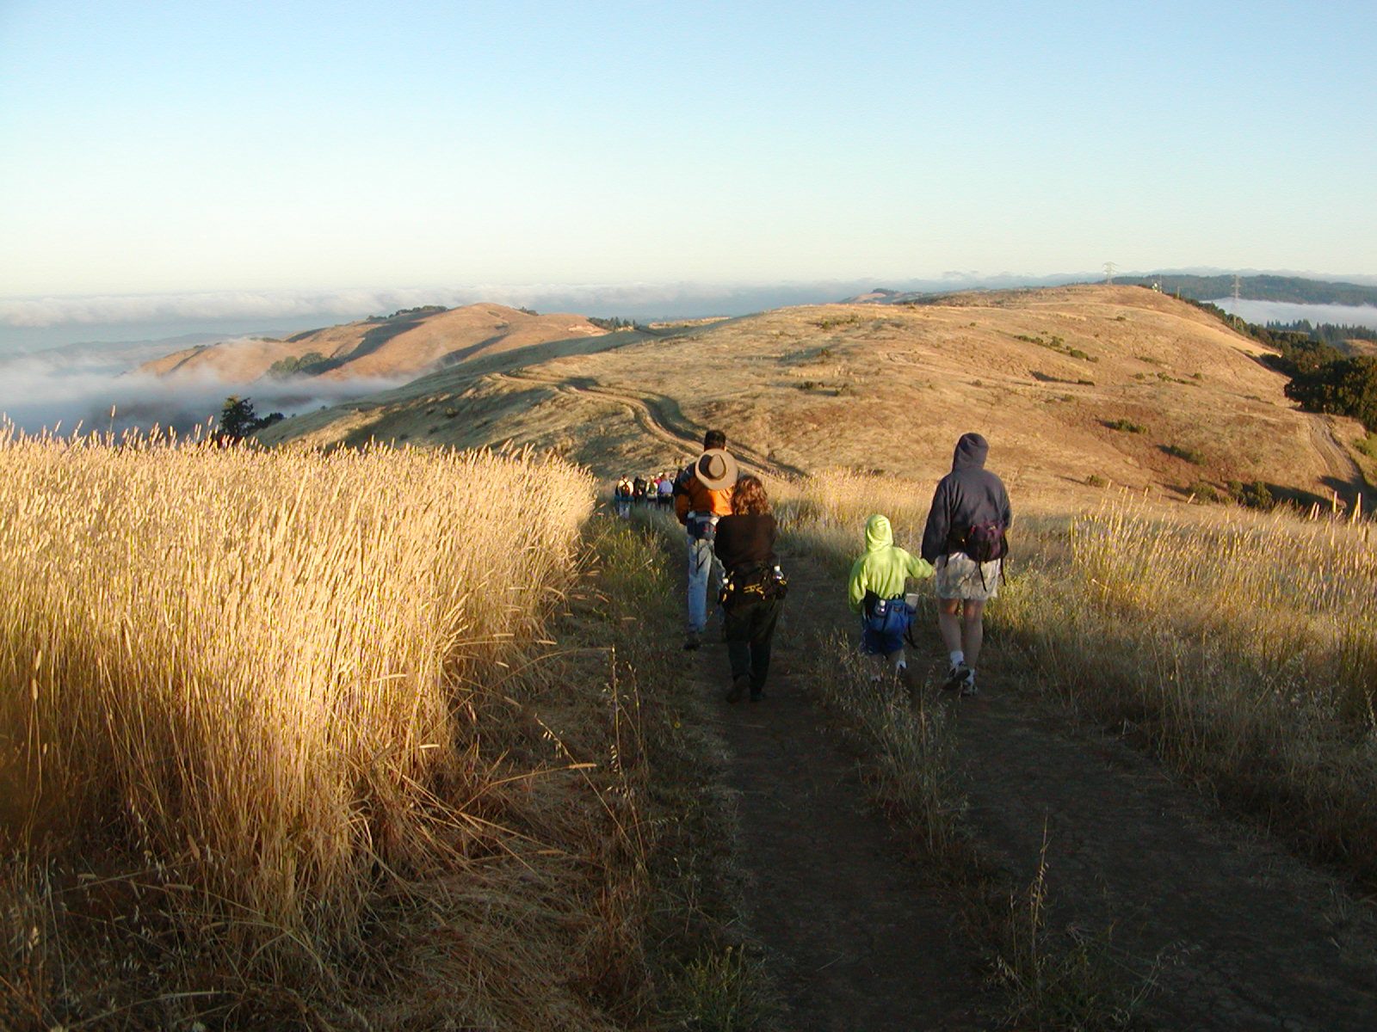
Strategic Plan
Build public awareness of Midpen and its work
Enhance regional collaboration
Strengthen financial and staffing resources
Notes:
The three strategies developed through Strategic Plan
Enhance regional collaboration -
Build public awareness and support
Build financial and staffing resources

Slide 9
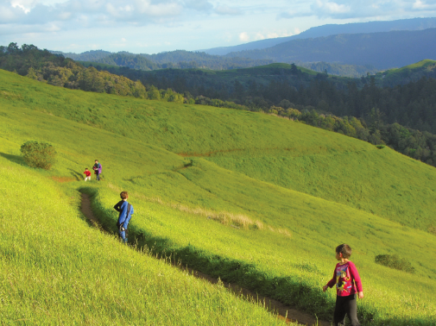
Vision Plan
Scientific polling to measure attitudes and awareness
Establish advisory committee
Expand engagement and education
Public priorities: access, acquisition & restoration
Develop priority project list that is geographically distributed
Through a public deliberation process, 25 high priority project areas identified, that were geographically distributed and would have the greatest benefit regionally. When costed out, the amount was $300 million. Were voters willing to pay?
Notes:
Scientific polling to better understand the public’s aspirations
Establishing a representative Community Advisory Committee
Expanded public engagement including telephone polls, focus groups, an interactive civic engagement web site, public workshops and public hearings.
Public education: a monthly e-newsletter, presentations, community events, outreach to underserved communities.
Results: key themes of public access, land preservation, and restoration and a detailed list of 54 high priority project portfolio areas.
Through a public deliberation process, 25 high priority project areas, that were geographically distributed and would have the greatest benefit regionally.
Separate from Vision Plan work were four scientific telephone polls (dates)on core values and District awareness, propensity to vote yes or no on potential funding measure and at what rate, and finally on 4 versions of ballot language based on past findings.

Slide 10
Ballot Language
Scientific telephone polls on core values, District awareness, propensity to vote yes or no, and potential ballot language.
“To improve access to hiking and biking opportunities, protect and preserve redwood forests, natural open spaces, the scenic beauty of our region and coastline, critical wildlife habitat, restore creeks to protect water quality, and reduce forest fire risk; shall Midpeninsula Regional Open Space District be authorized to issue up to $300 million in bonds, at a tax rate not to exceed $3.18 per $100,000 of assessed value of property owned, with expenditures verified by an independent citizen oversight committee?”
Notes:
We picked a GO Bond
A low number
Enabling us to increase capacity by 4-5x

Slide 11
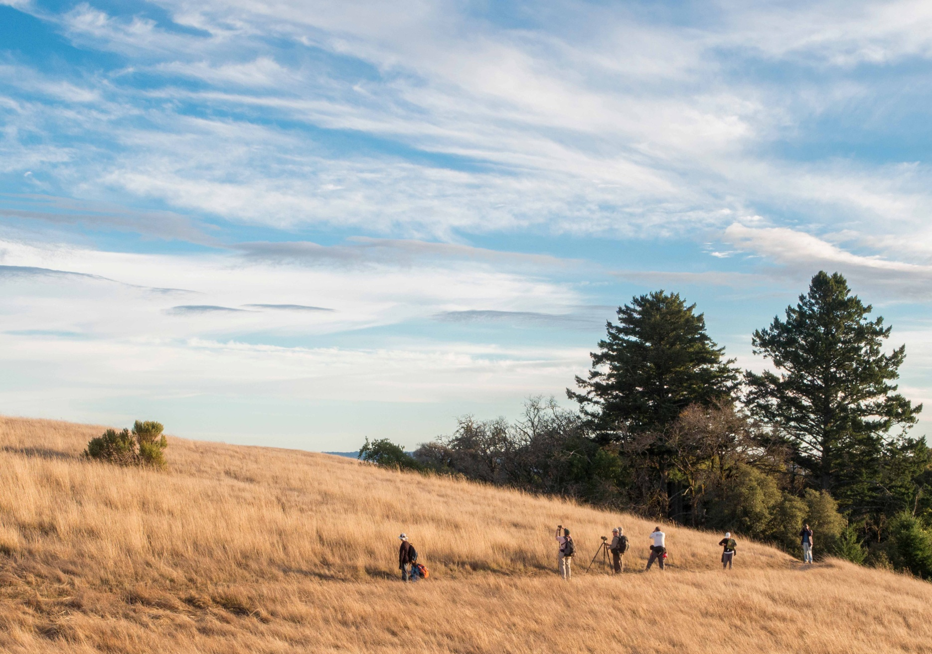
Measure AA
$300 million general obligation bond
Marked for capital projects only – 25 high priority project areas identified through vision plan.
$3.18 per $100,000 of assessed value
No sunset but likely within 20-30 years
Oversight committee to be established
Needed 2/3rd vote to pass; narrowly passed by 67%
$300 million general obligation bond
Marked for capital projects only – 25 high priority project areas identified through vision plan.
$3.18 per $100,000 of assessed value
No sunset, but authorization to bond for 30 years
Bond oversight committee to be established
Needed 2/3rd vote to pass; narrowly passed by 68%
Notes:
If asked – property owners pay about $17 per 100,000 assessed value overall; this is an additional $3.18.

Slide 12
Keys to Success
Polling data matters – (ex: Independent Citizen Oversight Committee; local Redwood forests)
Engaged Board
Consistent branding and strong outreach
A clear story that includes: what the public wants, the district’s solution and an affordable mechanism to make it happen
Strong internal coordination: deadlines, financial modeling, public education, planning, timing
Strong partnerships to run campaign (POST and Sempervirens)
Notes:
Board aware and engaged
Clear story that makes sense and is affordable: understand what the public wants, a plan to make that happen, an affordable mechanism to fund it way to fund it
Internal coordination: figure out the best election timing and work backwards from that and need to make an organizational shift to produce educational materials, financial modeling to scale up and grow apace

Slide 13
Keys to Success (cont.)
Campaign
Raise money
Get volunteers (telephone calls and precinct walking)
Get endorsements
Mailings, advertising, etc.
Editorial boards
Campaign web site
District Public Education
City council informational presentations
Meetings with local legislators
Community events
E-newsletter and social media
Engage reporters
Vision Plan web site
Be prepared to retool the organization to fulfill every commitment made to the public
Notes:
Prepare staff to understand the difference between education and campaign
Don’t underestimate the importance of a public education and outreach effort
Remember exactly what you said and retool to fulfill those commitments

Slide 14
Thank you
Visit www.openspace.org

